Slide 1
Exporting SQL
Guide 06

Slide 2
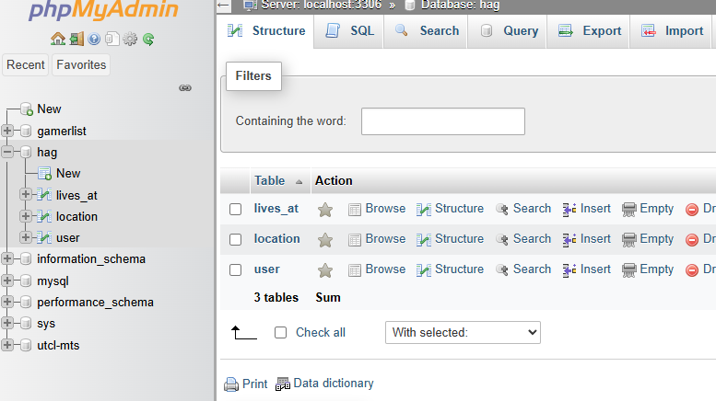
To export your database
Click "export"

Slide 3
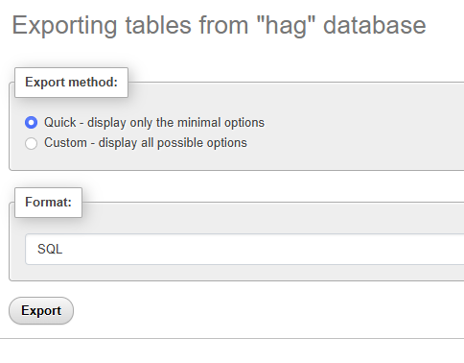
Choose your options
Quick will give you everything, more or less
Custom will allow you to select what you want.

Slide 4
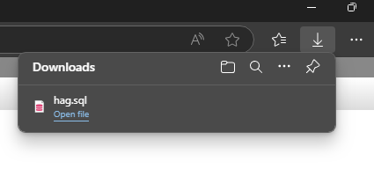
Locate the downloaded file

